Slide 1
Structuring System Requirements:
Conceptual Data Modeling

Slide 2
Learning Objectives
Learn to draw Entity-Relationship (E-R) Diagrams Review the role of conceptual data modeling in overall design and analysis of an information system
Distinguish between unary, binary, and ternary relationships, and give an example of each
Define four basic types of business rules in an E-R diagram
10.<number>

Slide 3
Learning Objectives
Explain the role of CASE technology in the analysis and documentation of data required in an information system
Relate data modeling to process and logic modeling as different views describing an information system
10.<number>

Slide 4
Conceptual Data Modeling
Representation of organizational data
Purpose is to show rules about the meaning and interrelationships among data
Entity-Relationship (E-R) diagrams are commonly used to show how data are organized
Main goal of conceptual data modeling is to create accurate E-R diagrams
Methods such as interviewing, questionnaires and JAD are used to collect information
Consistency must be maintained between process flow, decision logic and data modeling descriptions
10.<number>

Slide 5
Process of Conceptual Data Modeling
First step is to develop a data model for the system being replaced
Next, a new conceptual data model is built that includes all the requirements of the new system
In the design stage, the conceptual data model is translated into a physical design
Project repository links all design and data modeling steps performed during SDLC
10.<number>

Slide 6
Deliverables and Outcome
Primary deliverable is the entity-relationship diagram
There may be as many as 4 E-R diagrams produced and analyzed during conceptual data modeling
  Covers just data needed in the project’s application
  E-R diagram for system being replaced
  An E-R diagram for the whole database from which the new application’s data are extracted
  An E-R diagram for the whole database from which data for the application system being replaced is drawn
10.<number>

Slide 7
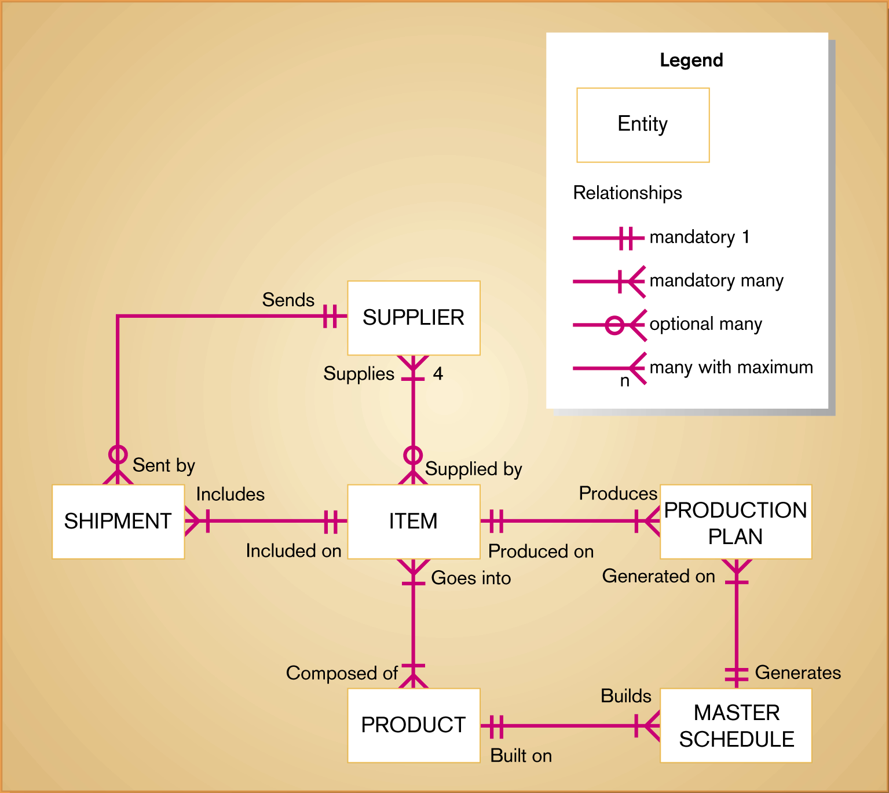
Figure 10-3
Sample conceptual data model diagram
10.<number>

Slide 8
Deliverables and Outcome
Second deliverable is a set of entries about data objects to be stored in repository or project dictionary
  Repository links data, process and logic models of an information system
  Data elements that are included in the DFD must appear in the data model and visa versa
  Each data store in a process model must relate to business objects represented in the data model
10.<number>

Slide 9
Gathering Information for Conceptual Data Modeling
Two perspectives
  Top-down
    Data model is derived from an intimate understanding of the business
  Bottom-up
    Data model is derived by reviewing specifications and business documents
10.<number>

Slide 10
Introduction to Entity-Relationship (E-R) Modeling
Notation uses three main constructs
  Data entities
  Relationships
  Attributes
Entity-Relationship (E-R) Diagram
  A detailed, logical representation of the entities, associations and data elements for an organization or business
10.<number>

Slide 11
Entity-Relationship (E-R) Modeling
Key Terms
Entity
  A person, place, object, event or concept in the user environment about which the organization wishes to maintain data
  Represented by a rectangle in E-R diagrams
Entity Type
  A collection of entities that share common properties or characteristics
Attribute
  A named property or characteristic of an entity that is of interest to an organization
10.<number>

Slide 12
Entity-Relationship (E-R) Modeling
Key Terms
Candidate keys and identifiers
  Each entity type must have an attribute or set of attributes that distinguishes one instance from other instances of the same type
  Candidate key
    Attribute (or combination of attributes) that uniquely identifies each instance of an entity type
10.<number>

Slide 13
Entity-Relationship (E-R) Modeling
Key Terms
Identifier
  A candidate key that has been selected as the unique identifying characteristic for an entity type
  Selection rules for an identifier
    Choose a candidate key that will not change its value
    Choose a candidate key that will never be null
    Avoid using intelligent keys
    Consider substituting single value surrogate keys for large composite keys
10.<number>

Slide 14
Entity-Relationship (E-R) Modeling
Key Terms
Multivalued Attribute
  An attribute that may take on more than one value for each entity instance
  Represented on E-R Diagram in two ways:
    double-lined ellipse
    weak entity
10.<number>

Slide 15
Entity-Relationship (E-R) Modeling
Key Terms
Relationship
  An association between the instances of one or more entity types that is of interest to the organization
  Association indicates that an event has occurred or that there is a natural link between entity types
  Relationships are always labeled with verb phrases
10.<number>

Slide 16
Conceptual Data Modeling and the E-R Diagram
Goal
  Capture as much of the meaning of the data as possible
Result
  A better design that is easier to maintain
10.<number>

Slide 17
Degree of Relationship
Degree
  Number of entity types that participate in a relationship
Three cases
  Unary
    A relationship between two instances of one entity type
  Binary
    A relationship between the instances of two entity types
  Ternary
    A simultaneous relationship among the instances of three entity types
    Not the same as three binary relationships
10.<number>

Slide 18
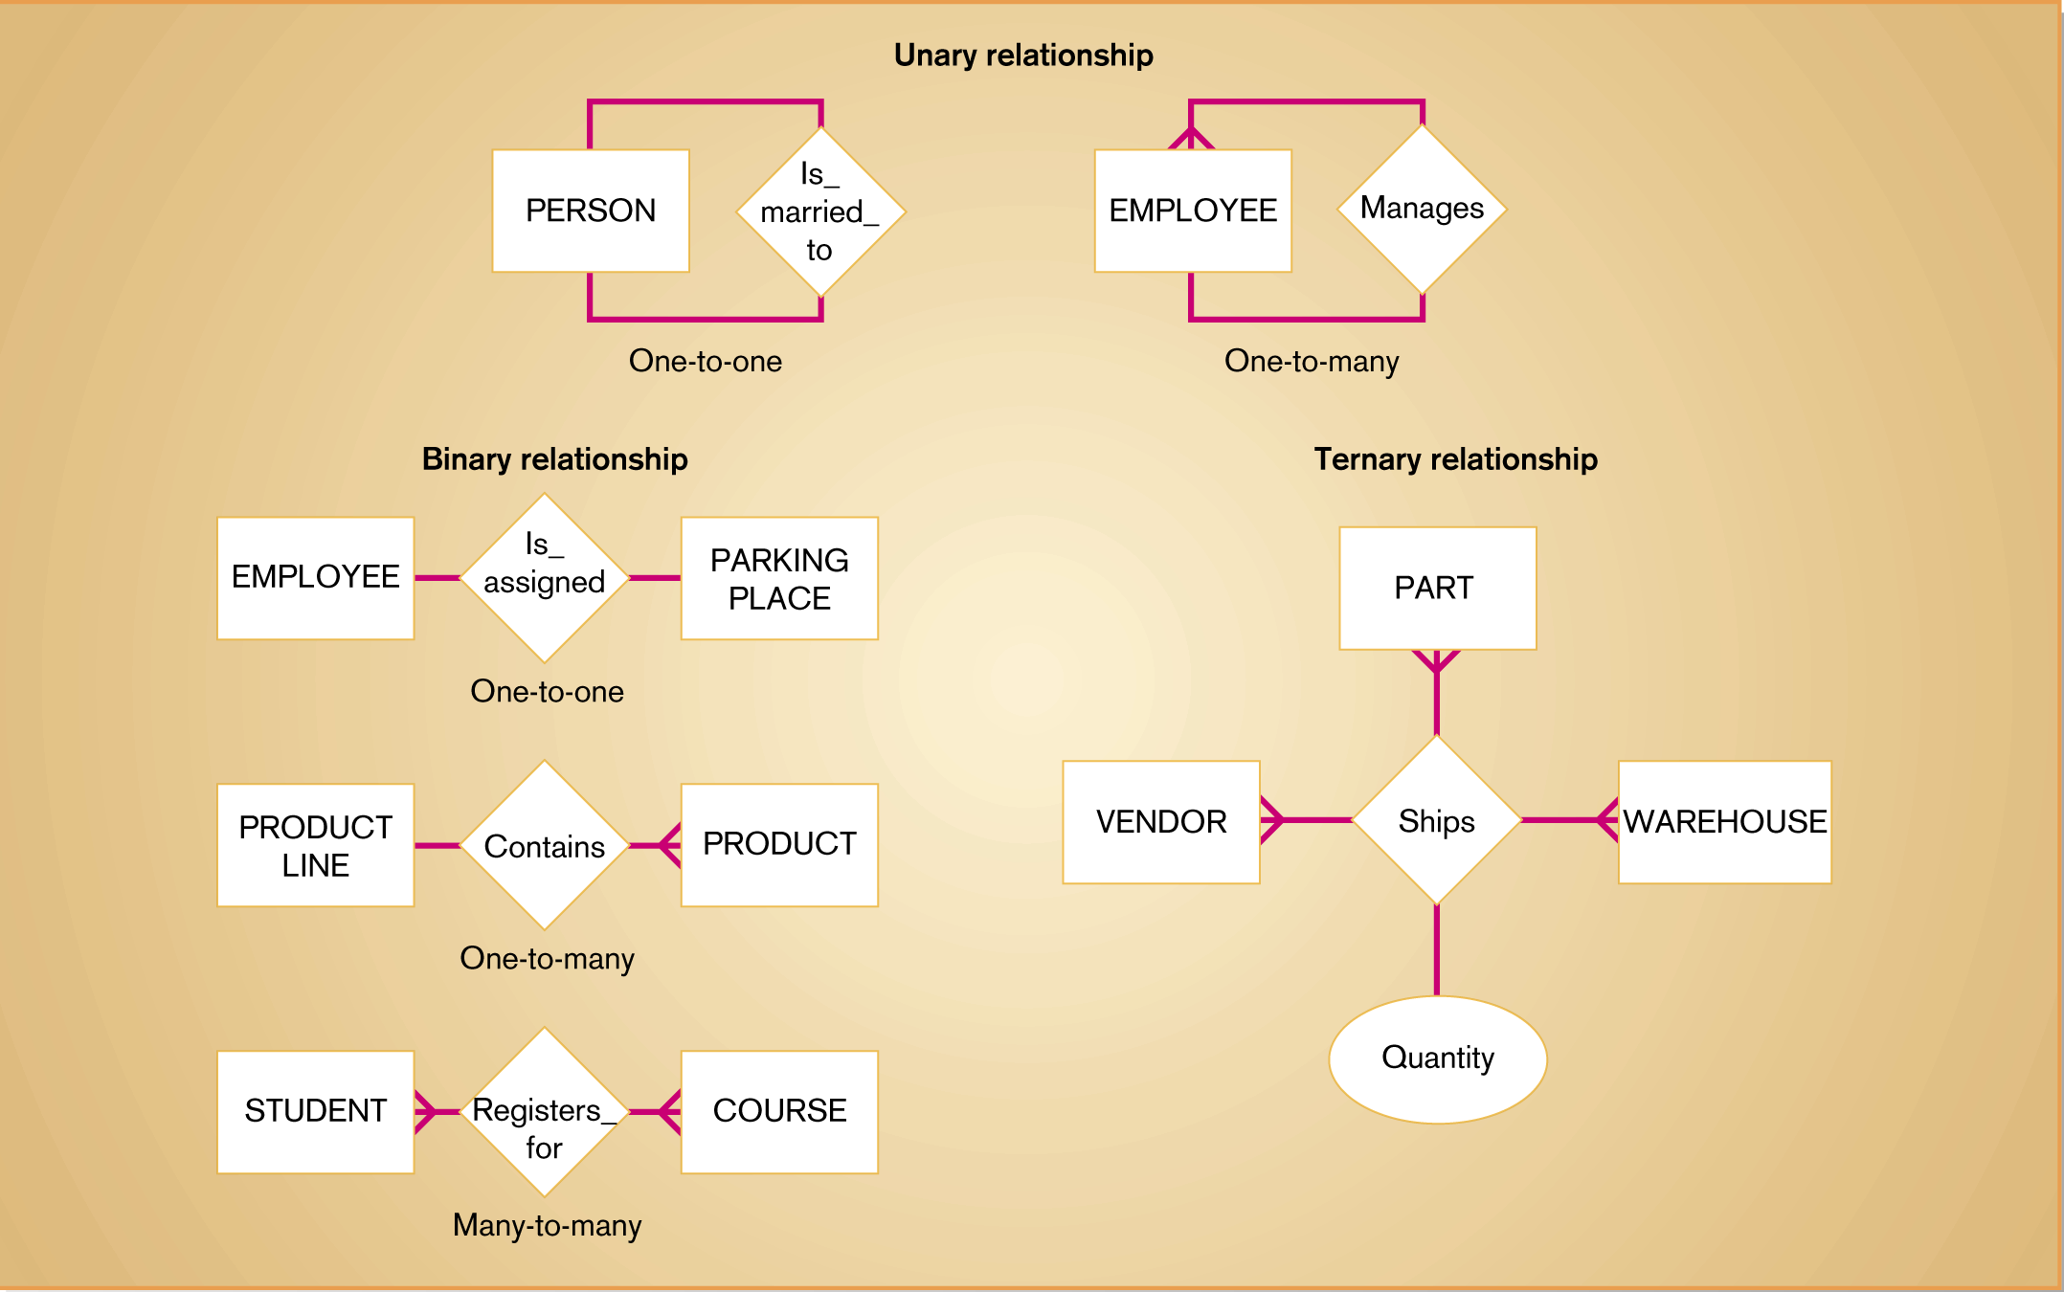
Figure 10-6
Example relationships of different degrees
10.<number>

Slide 19
Cardinality
The number of instances of entity B that can be associated with each instance of entity A
Minimum Cardinality
  The minimum number of instances of entity B that may be associated with each instance of entity A
Maximum Cardinality
  The maximum number of instances of entity B that may be associated with each instance of entity A
10.<number>

Slide 20
Naming and Defining Relationships
Relationship name is a verb phrase
Avoid vague names
Guidelines for defining relationships
  Definition explains what action is being taken and why it is important
  Give examples to clarify the action
  Optional participation should be explained
  Explain reasons for any explicit maximum cardinality
10.<number>

Slide 21
Naming and Defining Relationships
Guidelines for defining relationships
  Explain any restrictions on participation in the relationship
  Explain extent of the history that is kept in the relationship
  Explain whether an entity instance involved in a relationship instance can transfer participation to another relationship instance
10.<number>

Slide 22
Associative Entity
An entity type that associates the instances of one or more entity types and contains attributes that are peculiar to the relationship between those entity instances
10.<number>

Slide 23
Domains
The set of all data types and ranges of values that an attribute can assume
Several advantages
  Verify that the values for an attribute are valid
  Ensure that various data manipulation operations are logical
  Help conserve effort in describing attribute characteristics
10.<number>

Slide 24
Triggering Operations
An assertion or rule that governs the validity of data manipulation operations such as insert, update and delete
Includes the following components:
  User rule
    Statement of the business rule to be enforced by the trigger
  Event
    Data manipulation operation that initiates the operation
  Entity Name
    Name of entity being accessed or modified
  Condition
    Condition that causes the operation to be triggered
  Action
    Action taken when the operation is triggered
10.<number>

Slide 25
Triggering Operations
Responsibility for data integrity lies within scope of database management system, not individual applications
10.<number>

Slide 26
The Role of CASE in Conceptual Data
CASE tools provide two important functions:
  Maintain E-R diagrams as a visual depiction of structured data requirements
  Link objects on E-R diagrams to corresponding descriptions in a repository
10.<number>

Slide 27
Summary
Process of conceptual data modeling
  Deliverables
  Gathering information
Entity-Relationship Modeling
  Entities
  Attributes
  Candidate keys and identifiers
  Multivalued attributes
Degree of relationship
10.<number>

Slide 28
Summary
Cardinality
Naming and defining relationships
Associative entities
Domains
Triggering Operations
Role of CASE
10.<number>

